Slide 1

INF2009F Introduction Lecture
“Dreams don’t work unless you do” (John C. Maxwell)
Lectures: Ayanda Pekane
Maureen Tanner
Popyeni Kautondokwa

Slide 2


Introduction
Ayanda Pekane
Course convener & Lecture
ayanda.pekane@uct.ac.za
Maureen Tanner
Lecturer
mc.tanner@uct.ac.za
Popyeni Kautondokwa
ktnpop001@myuct.ac.za
Gilah Poggenpoel
Course administrator
gilah.poggenpoel@uct.ac.za

Slide 3

IS Degree Structure
First Year
Foundations
Commercial Programming
Second Year
Systems Development (analysis, design & implementation )
Databases Systems/Software Architecture
Third year
Group Project eCommerce
Business processes / ERP’s

Slide 4
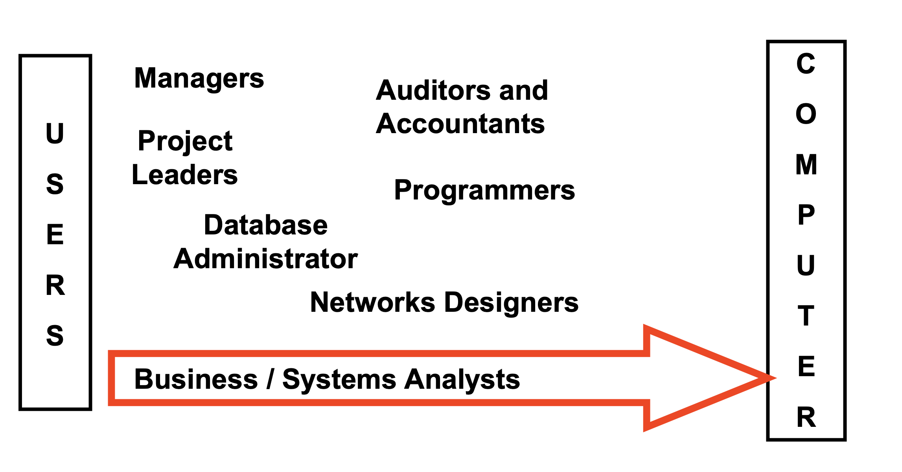
Who builds computer systems

Slide 5
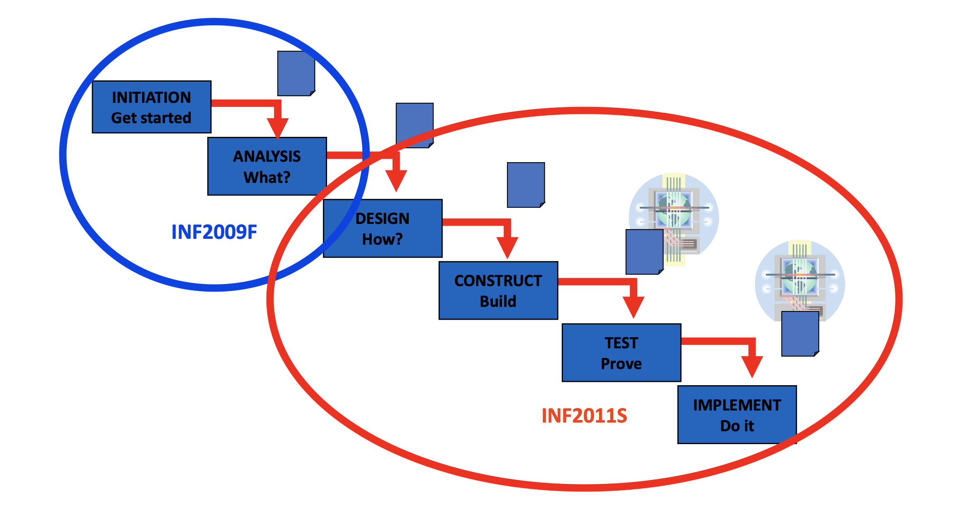
Systems Development Lifecycle

Slide 6

Course Objectives
On completion students should be able to:
Understand the context of analysis, design and implementation stages within the SDLC
Explain key object-oriented concepts and techniques
Document user requirements using Object Oriented Analysis techniques and UML
Develop a detailed Business Case and User Requirements Specification

Slide 7

Learning Process (See attached Course Schedule)
Lesson will follow the development life cycle - flipped classroom approach with strong emphasis on lesson discussions and worked examples
Individual Exercises and Team Workshops will build on theory and discussion during lectures. This will allow students to apply the systems development tools and techniques to different case study examples.
Project (assignments). Students will enforce their understanding of techniques practiced in the workshops by completing a significant development project (using the same case study example).
The Project assignments will be a culmination of the workshops done throughout the semester with students working in teams of four
The Project deliverables are a Business Case (BC) and User Requirements Specification (URS)

Slide 8

Learning Materials
Introduction to Systems Analysis and Design in a Changing World, 7th Edition by John W. Satzinger (Author), Robert B. Jackson (Author), Stephen D. Burd (Author)
Amathuba Resources
Lesson Slides, Articles, videos (Linkedin Learning)
Worked examples (in class)
Individual Exercises
Team Workshops
Templates, guidance documents and readings

Slide 9



Lesson Overview
Weekly guide on
Weekly lessons
Weekly deliverables (Exercises, workshops & assignments)
Extra reading/ video material
Posted Monday by 9am

Slide 10

Hints for passing
Go through the material specified in the lesson plan before every lesson
Complete individual exercises & engage during F2F lectures and F2F workshop sessions, and online hotseats
Workshop deliverables fundamental to the project and final assessment
Understand how to work as a team
Build a support structure around your team
Don’t ignore problems until it is too late

Slide 11
Course assessment
Activity | Percentage
Indiv Exercises | 25%
Workshops (Team) | 15%
Assignments (Team) | 20%
Exam (Indiv) | 40%
DP Requirements
Attend 80% of the workshops
Complete 80% of Indiv Exercises
Complete project (2x assignments)
Year mark sub-minimum of 60%
Final assessment sub-minimum of 40%

Slide 12

Exercises
Go through material on Amathuba (see lesson plan for details)
Complete exercises (80% should be completed for DP)
Exercises are to be submitted on Amathuba on a weekly basis (dates are uploaded on Amathuba and outlined on the lesson plan pages)
Formative feedback will be given for each submission
A possible solution to an exercise will be given
Late submissions will be penalised as follows:
Day 1 – 2% for the first day late or part thereof (1 second late is late)
Additional Days – 1% point for each day thereafter, with a maximum of 4% (3 days).
Emailed assignments will not be marked.

Slide 13

Workshops
Attendance is compulsory (15% of year mark) -
Work in teams of 4
8 Workshops
Workshops are to be submitted on Amathuba on a weekly basis (dates will be outlined on the lesson plan pages)
No model solution to workshops but feedback in the marked submission
Team Formation – Thursday, 15th February

Slide 14

Teams and Workshops
Sign up on Amathuba
4 Sessions
Teams of 4
Tools
MS Teams
Draw.IO
Don’t include the names of the individuals who did not contribute

Slide 15
Tutors
C1 Workshop Session 1 10:00 – 12:00 HAHN1
Tutors
C2 Workshop Session 2 11:00 – 13:00 HUM LT1A
Tutors
C3 Workshop Session 3 14:00 – 16:00 SNAPE TS4B
Tutors
C4 Workshop Session 4 16:00 – 18:00 CS203

Slide 16
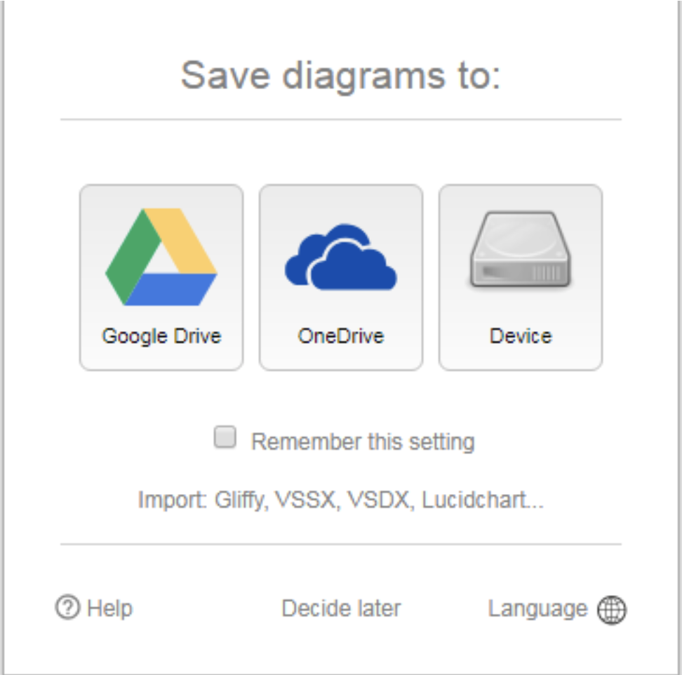
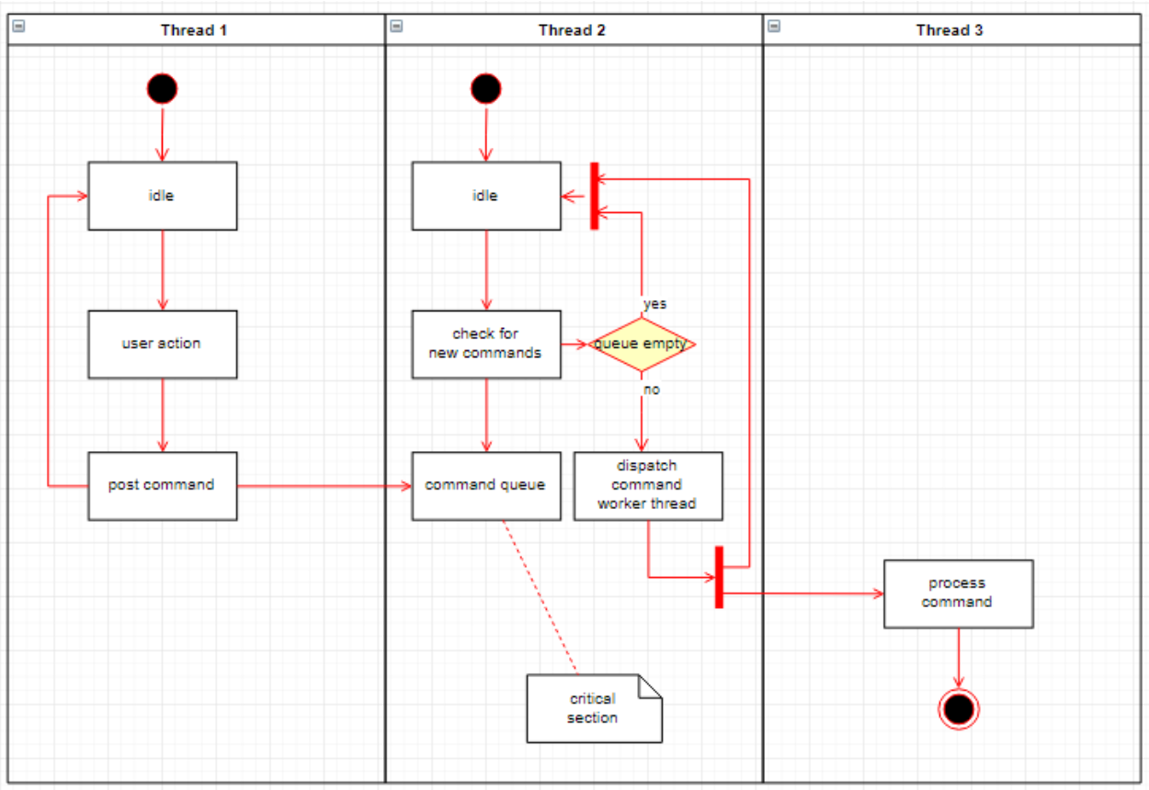

Draw.io
Use the guides we created for Draw.IO to assist with the installation

Slide 17

Case Study 1 Specno Case Study (Exercises)

Slide 18
Case Study 2 – Phumla Kamnandi (Workshops)
Enquiries & Reservations
Room allocation
Check in process
Room servicing
Accounts processing
Debtors
Creditors and replenishment
Banking
Staffing and Human Resources

Slide 19

Questions?

